Slide 1
LinkedIn Cheat Sheet
2022

Slide 2
Quick guide to get started on LinkedIn

Slide 3
How to Build the Best LinkedIn Profile
Did you know? An optimized profile page appears in more searches – connecting you closer to your employees and to your desired network.
Update your profile picture
Use an updated clean, professional headshot. This first step can lead to 21x more profile views and 9x more connection requests
Add a cover photo
A photo of yourself at a speaking engagement is a great opportunity to establish credibility. If you don’t have one, choose a Cognizant social cover here
Add your headline
Use a keyword-rich headline that represents the core areas/topics you want to be known for
Example of a great headline: Director of Proud Management at Cognizant, Tech Evangelist, and Formula 1 Fan
Add your summary
This should include more information about your role at Cognizant and a brief statement about what you are passionate about
Write in first person (I/We) and with a conversational tone to humanize your story
Review Brian Humphries’s summary as a great example located here
Add your work experience
Break down your last 5 to 10 work experiences. Pro tip: add a significant accomplishment to each job as it will give you additional opportunities to include key words for the algorithm
Add your education
List your highest academic level

Slide 4
Content thought starters
Before creating content, the following questions will help you to understand your key areas of focus, your authentic tone and what you are trying to achieve on LinkedIn.
Who do you want to reach?
Examples: Business leaders, sales professionals, potential employees, etc.
What topics are closely related to your goals at Cognizant?
Examples: Case studies, product launches, clint wins, etc.
What do you want to be known for as a leader?
Examples: Strategic, visionary, innovative, etc.
What messages do you want to share?
Examples: Earnings, DE&I, what we do, etc.
Any other topics or lifestyle interests that you’d like to amplify?
Examples: Leadership insights, personal stories, etc.
4
© 2022 Cognizant - Privileged and Confidential, Work Product

Slide 5
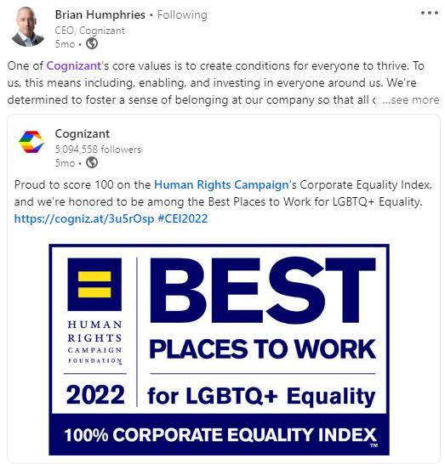
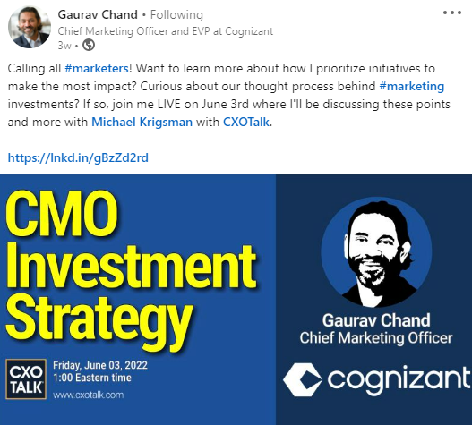
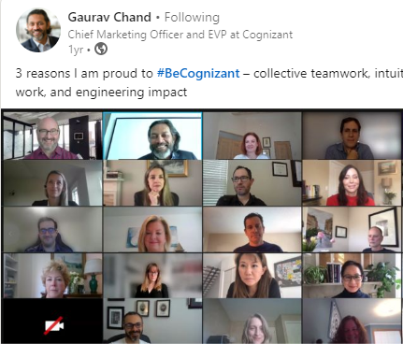
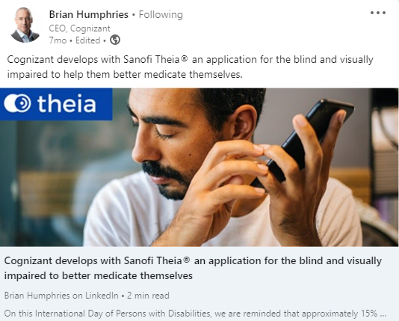
Key topic examples for LinkedIn
Cognizant Announcements
Examples: Company Awards, DE&I, Earnings, Key Updates
Leadership
Examples: Speaking Engagements, Career Advice, Professional Insights
Team Recognition
Examples: Workplace Culture, Team Awards, Internal Events
Value Proposition
Examples: Work We Do, Product and Service Releases, Client Wins

Slide 6
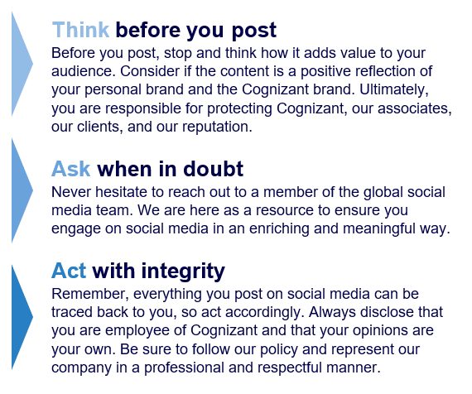
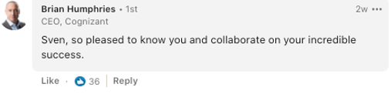
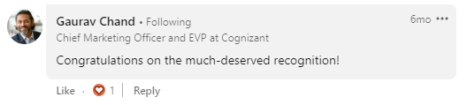
"How to" on creating and sharing content in 10 minutes
Executives actively engaging and sharing content on social enhances organic social media content, increases brand visibility, boosts credibility, and strengthens associate engagement
Carefully review the Cognizant Social Media policy document
Available via Be.Cognizant here
Ensure you are following Cognizant, Brian Humphries and other Executive Committee leaders on LinkedIn
Here is the link to Cognizant’s page and here is the link to Brian Humphries page
This will allow you to see when Cognizant and the EC posts. This is a great opportunity to like, comment, and share the posts
Review your notifications and connection invitations
Engage with comments on your posts by liking or replying (examples on the right)
Accept or decline connection invitations
Scroll through your home newsfeed
Look for opportunities to engage on your connection’s posts by liking or commenting
Engage with trending posts about topics that interest you
Share relevant, interesting topics or news
Share newsworthy Cognizant content by simply clicking on the “Share” button below the post
Review the key topic examples on slide 5 for post inspiration
Be authentic and conversational with your copy
Utilize Cognizant hashtags:
#BeCognizant (culture, value, workplace, etc.)
#IntuitionEngineered (case studies, products, services, etc.)
#CognizantOutreach (volunteering activities, etc.)
A solid social presence can contain author original content and sharing others such as Cognizant’s posts
Continue with this process 2x or 3x a month
Be consistent, timely and flexible
Continue to blend professional and personal updates

Slide 7





Thank you! If you have any additional questions, please contact Kelsey.Paige@cognizant.com
Follow us on our social networks!
@Cognizant

